Slide 1
15
Stream
Input/Output

Slide 2
Consciousness… does not appear to itself chopped up in bits… A “river” or a “stream” are the metaphors by which it is most naturally described.
  William James
All the news that’s fit to print.
  Adolph S. Ochs
Remove not the landmark on the boundary of the fields.
  Amenehope

Slide 3
OBJECTIVES
In this chapter you will learn:
To use C++ object-oriented stream input/output.
To format input and output.
The stream-I/O class hierarchy.
To use stream manipulators.
To control justification and padding.
To determine the success or failure of input/output operations.
To tie output streams to input streams.

Slide 4
15.1 Introduction
15.2 Streams
15.2.1 Classic Streams vs. Standard Streams
15.2.2 iostream Library Header Files
15.2.3 Stream Input/Output Classes and Objects
15.3 Stream Output
15.3.1 Output of char* Variables
15.3.2 Character Output using Member Function put
15.4 Stream Input
15.4.1 get and getline Member Functions
15.4.2 istream Member Functions peek, putback and ignore
15.4.3 Type-Safe I/O
15.5 Unformatted I/O using read, write and gcount

Slide 5
15.6 Introduction to Stream Manipulators
15.6.1 Integral Stream Base: dec, oct, hex and setbase
15.6.2 Floating-Point Precision (precision, setprecision)
15.6.3 Field Width (width, setw)
15.6.4 User-Defined Output Stream Manipulators
15.7 Stream Format States and Stream Manipulators
15.7.1 Trailing Zeros and Decimal Points (showpoint)
15.7.2 Justification (left, right and internal)
15.7.3 Padding (fill, setfill)
15.7.4 Integral Stream Base (dec, oct, hex, showbase)
15.7.5 Floating-Point Numbers; Scientific and Fixed Notation (scientific, fixed)
15.7.6 Uppercase/Lowercase Control (uppercase)
15.7.7 Specifying Boolean Format (boolalpha)
15.7.8 Setting and Resetting the Format State via Member-Function flags

Slide 6
15.8 Stream Error States
15.9 Tying an Output Stream to an Input Stream
15.10 Wrap-Up

Slide 7
15.1 Introduction
C++ standard library input/output capabilities
  Many I/O features are object oriented
  Type-safe I/O
    I/O operations are sensitive data types
    Improper data cannot “sneak” through
  Extensibility allows users to specify I/O for user-defined types
    Overloading the stream insertion and extraction operators

Slide 8
Software Engineering Observation 15.1
Use the C++-style I/O exclusively in C++ programs, even though C-style I/O is available to C++ programmers.

Slide 9
Error-Prevention Tip 15.1
C++ I/O is type safe.

Slide 10
Software Engineering Observation 15.2
C++ enables a common treatment of I/O for predefined types and user-defined types. This commonality facilitates software development and reuse.

Slide 11
15.2 Streams
C++ I/O occurs in streams – sequences of bytes
  Input
    Bytes flow from a device to main memory
  Output
    Bytes flow from main memory to a device
  I/O transfers typically take longer than processing the data

Slide 12
15.2 Streams (Cont.)
“Low-level”, unformatted I/O
  Individual bytes are the items of interest
  High-speed, high-volume
  Not particularly convenient for programmers
“High-level”, formatted I/O
  Bytes are grouped into meaningful units
    Integers, floating-point numbers, characters, etc.
  Satisfactory for most I/O other than high-volume file processing

Slide 13
Performance Tip 15.1
Use unformatted I/O for the best performance in high-volume file processing.

Slide 14
Portability Tip 15.1
Using unformatted I/O can lead to portability problems, because unformatted data is not portable across all platforms.

Slide 15
15.2.1 Classic Streams vs. Standard Streams
C++ classic stream libraries
  Enable input and output of chars (single bytes)
ASCII character set
  Uses single bytes
  Represents only a limited set of characters
Unicode character set
  Represents most of the world’s commercially viable languages, mathematical symbols and more
  www.unicode.org

Slide 16
15.2.1 Classic Streams vs. Standard Streams (Cont.)
C++ standard stream libraries
  Enables I/O operations with Unicode characters
  Class template versions of classic C++ stream classes
    Specializations for processing characters of types char and wchar_t
      wchar_ts can store Unicode characters

Slide 17
15.2.2 iostream Library Header Files
<iostream> header file
  Declares basic services required for all stream-I/O operations
  Defines cin, cout, cerr and clog
  Provides both unformatted- and formatted-I/O services
<iomanip> header file
  Declares services for performing formatted I/O with parameterized stream manipulators
<fstream> header file
  Declares services for user-controlled file processing

Slide 18
15.2.3 Stream Input/Output Classes and Objects
Class templates in the iostream library
  basic_istream
    Supports stream-input operations
  basic_ostream
    Supports stream-output operations
  basic_iostream
    Supports both stream-input and stream-output operations

Slide 19
15.2.3 Stream Input/Output Classes and Objects (Cont.)
typedefs
  Declare synonyms for previously defined data types
    Example
      typedef Card *CardPtr;
        Makes CardPtr a synonym for type Card *
  Used to create shorter or more readable type names

Slide 20
15.2.3 Stream Input/Output Classes and Objects (Cont.)
typedefs in <iostream> library
  istream
    Represents a specialization of basic_istream
    Enables char input
  ostream
    Represents a specialization of basic_ostream
    Enables char output
  iostream
    Represents a specialization of basic_iostream
    Enables char input and output

Slide 21
15.2.3 Stream Input/Output Classes and Objects (Cont.)
Stream-I/O template hierarchy
  basic_istream and basic_ostream derive from basic_ios
  basic_iostream derives from basic_istream and basic_ostream
    Uses multiple inheritance
Stream operator overloading
  Stream insertion operator
    Left-shift operator (<<) is overloaded for stream output
  Stream extraction operator
    Right-shift operator(>>) is overloaded for stream input

Slide 22

Fig. 15.1 | Stream-I/O template hierarchy portion.

Slide 23
15.2.3 Stream Input/Output Classes and Objects (Cont.)
Standard stream objects
  istream instance
    cin
      Connected to the standard input device, usually the keyboard
  ostream instances
    cout
      Connected to the standard output device, usually the display screen
    cerr
      Connected to the standard error device
      Unbuffered - output appears immediately
    clog
      Connected to the standard error device
      Buffered - output is held until the buffer is filled or flushed

Slide 24
15.2.3 Stream Input/Output Classes and Objects (Cont.)
File-Processing Templates
  basic_ifstream
    For file input
    Inherits from basic_istream
  basic_ofstream
    For file output
    Inherits from basic_ostream
  basic_fstream
    For file input and output
    Inherits from basic_iostream
typedef specializations
  ifstream, ofstream and fstream

Slide 25
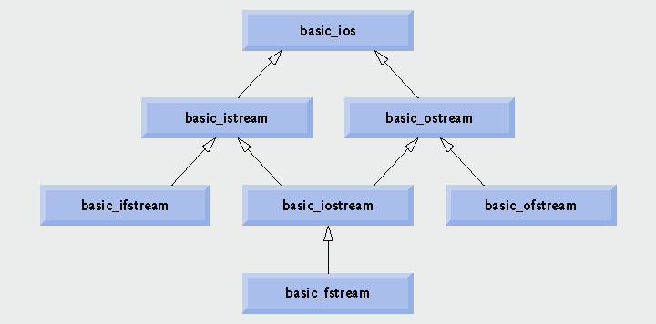
Fig. 15.2 | Stream-I/O template hierarchy portion showing the main file-processing templates.

Slide 26
15.3 Stream Output
ostream output capabilities
  Can output
    Standard data types
    Characters
    Unformatted data
    Integers
    Floating-point values
    Values in fields

Slide 27
15.3.1 Output of char * Variables
Outputting char * (memory address of a char)
  Cannot use << operator
    Has been overloaded to print char * as a null-terminated string
  Solution
    Cast the char * to a void *
  Address is printed as a hexadecimal (base-16) number

Slide 28
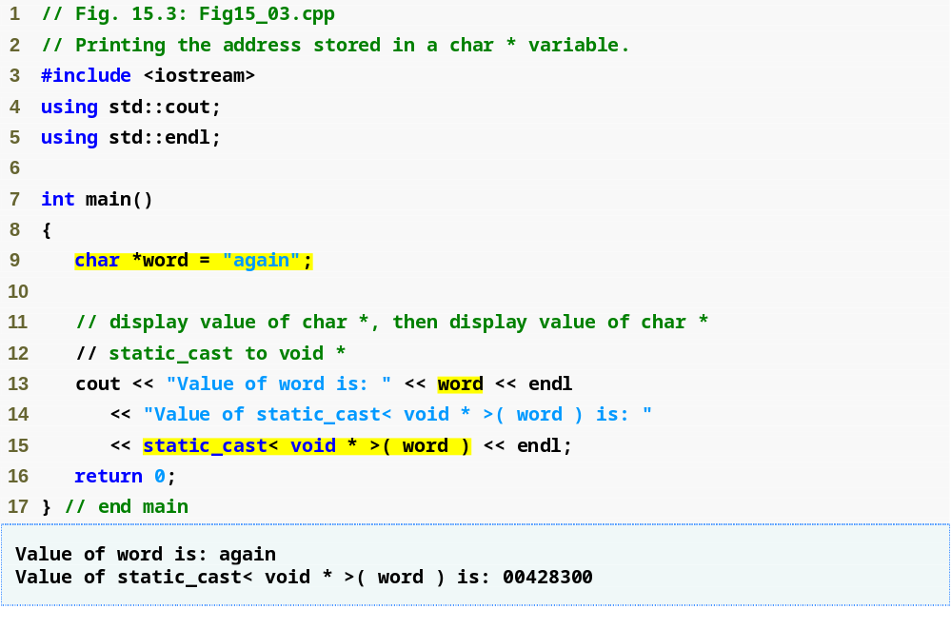
Outline
Fig15_03.cpp
(1 of 1)
Cast the char * to a void *
Address prints as a hexadecimal (base-16) number

Slide 29
15.3.2 Character Output using Member Function put
ostream member function put
  Outputs a character
  Returns a reference to the same ostream object
    Can be cascaded
  Can be called with a numeric expression that represents an ASCII value
  Examples
    cout.put( 'A' );
    cout.put( 'A' ).put( '\n' );
    cout.put( 65 );

Slide 30
15.4 Stream Input
istream input capabilities
  Stream extraction operator (overloaded >> operator)
    Skips over white-space characters
    Returns a reference to the istream object
  When used as a condition, void * cast operator is implicitly invoked
    Converts to non-null pointer (true) or null pointer (false)
      Based on success or failure of last input operation
        An attempt to read past end of stream is one such failure

Slide 31
15.4 Stream Input (Cont.)
istream input capabilities (Cont.)
  State bits
    Control the state of the stream
    failbit
      Set if input data is of wrong type
    badbit
      Set if stream extraction operation fails

Slide 32
15.4.1 get and getline Member Functions
istream member function get
  With no arguments
    Returns one character input from the stream
      Any character, including white-space and non-graphic characters
    Returns EOF when end-of-file is encountered
  With a character-reference argument
    Stores input character in the character-reference argument
    Returns a reference to the istream object

Slide 33
15.4.1 get and getline Member Functions (Cont.)
istream member function get (Cont.)
  With three arguments: a character array, a size limit and a delimiter (default delimiter is '\n' )
    Reads and stores characters in the character array
    Terminates at one fewer characters than the size limit or upon reading the delimiter
      Delimiter is left in the stream, not placed in array
    Null character is inserted after end of input in array
istream member function eof
  Returns false when end-of-file has not occurred
  Returns true when end-of-file has occurred

Slide 34
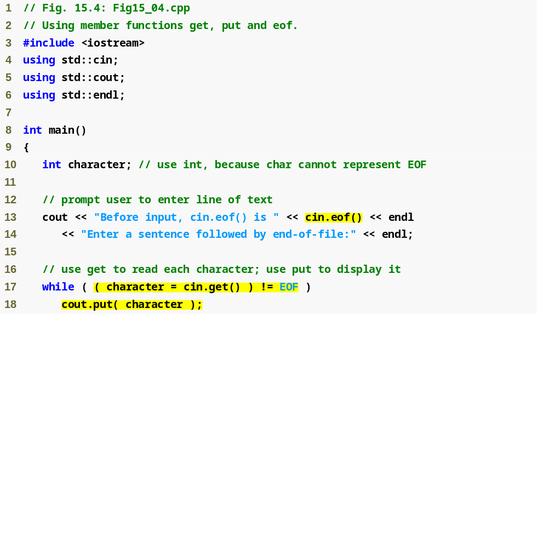
Outline
Fig15_04.cpp
(1 of 2)
Call eof member function before end-of-file is reached
while loop terminates when get member function returns EOF

Slide 35
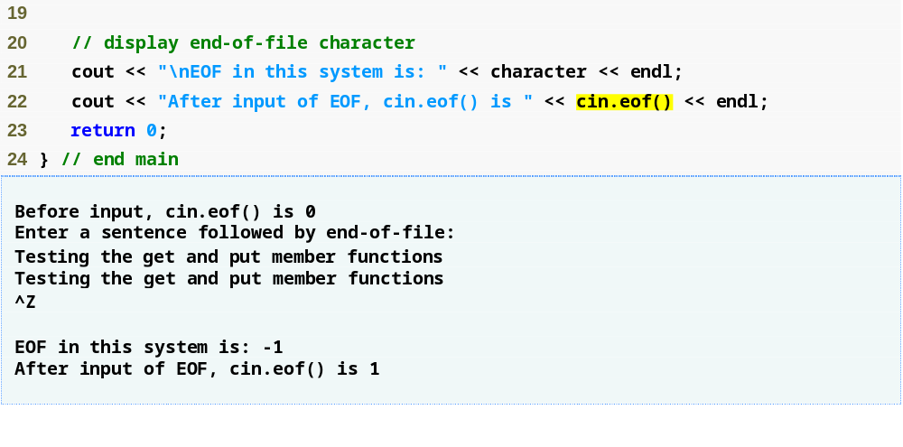
Outline
Fig15_04.cpp
(2 of 2)
Display character, which currently contains the value of EOF
Call eof member function after end-of-file is reached
End-of-file is represented by <ctrl>-z on Microsoft Windows systems, <ctrl>-d on UNIX and Macintosh systems.

Slide 36
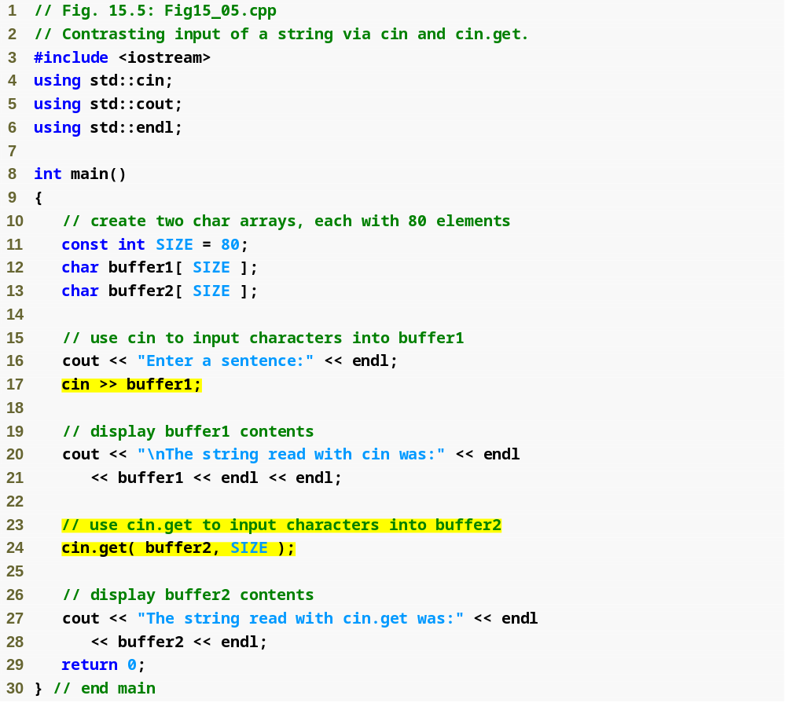
Outline
Fig15_05.cpp
(1 of 2)
Use stream extraction with cin
Call three-argument version of member function get (third argument is default value '\n')

Slide 37
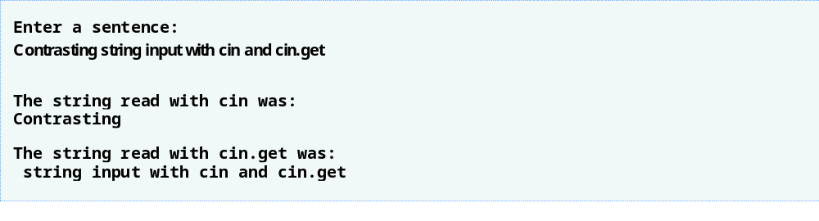
Outline
Stream extraction operation reads up to first white-space character
Fig15_05.cpp
(1 of 2)
get member function reads up to the delimiter character '\n'

Slide 38
15.4.1 get and getline Member Functions (Cont.)
istream member function getline
  (Similar to the three-argument version of get
    Except the delimiter is removed from the stream)
  Three arguments: a character array, a size limit and a delimiter (default delimiter is '\n' )
    Reads and stores characters in the character array
    Terminates at one fewer characters than the size limit or upon reading the delimiter
      Delimiter is removed from the stream, but not placed in the array
    Null character is inserted after end of input in array

Slide 39
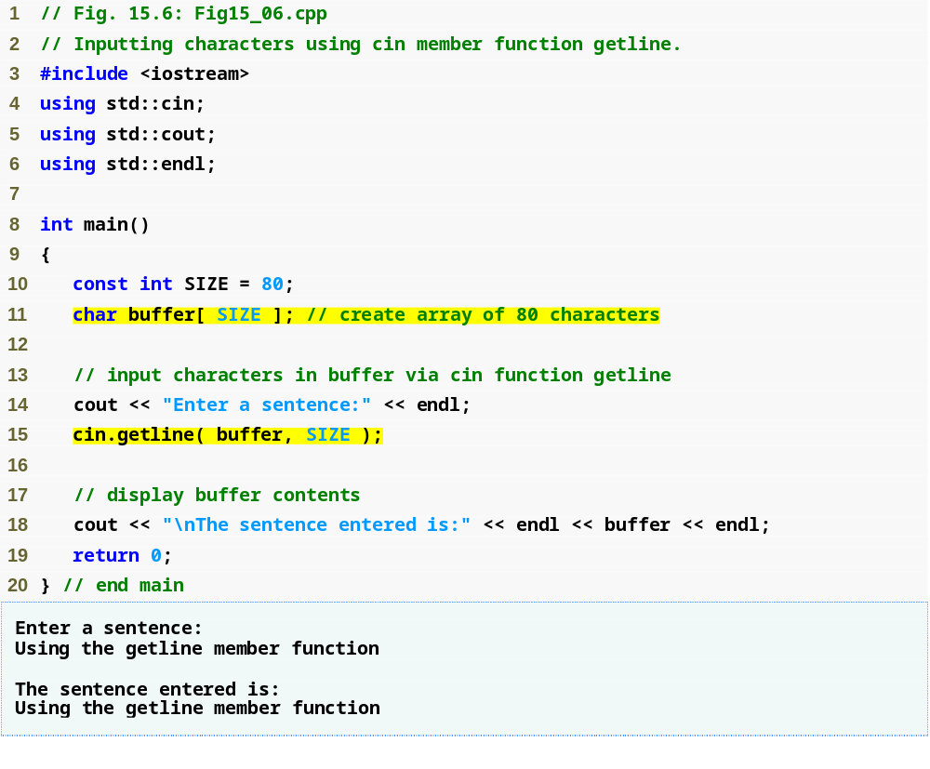
Outline
Fig15_06.cpp
(1 of 1)
Call member function getline

Slide 40
15.4.2 istream Member Functions peek, putback and ignore
istream member function ignore
  Reads and discards a designated number of characters or terminates upon encountering a designated delimiter
    Default number of characters is one
    Default delimiter is EOF
istream member function putback
  Places previous character obtained by a get from the input stream back into the stream
istream member function peek
  Returns the next character in the input stream, but does not remove it from the stream

Slide 41
15.4.3 Type-Safe I/O
C++ offers type-safe I/O
  << and >> operators are overloaded to accept data of specific types
    Attempts to input or output a user-defined type that << and >> have not been overloaded for result in compiler errors
  If unexpected data is processed, error bits are set
    User may test the error bits to determine I/O operation success or failure
  The program is able to “stay in control”

Slide 42
15.5 Unformatted I/O Using read, write and gcount
istream member function read
  Inputs some number of bytes to a character array
  If fewer characters are read than the designated number, failbit is set
istream member function gcount
  Reports number of characters read by last input operation
ostream member function write
  Outputs some number of bytes from a character array

Slide 43
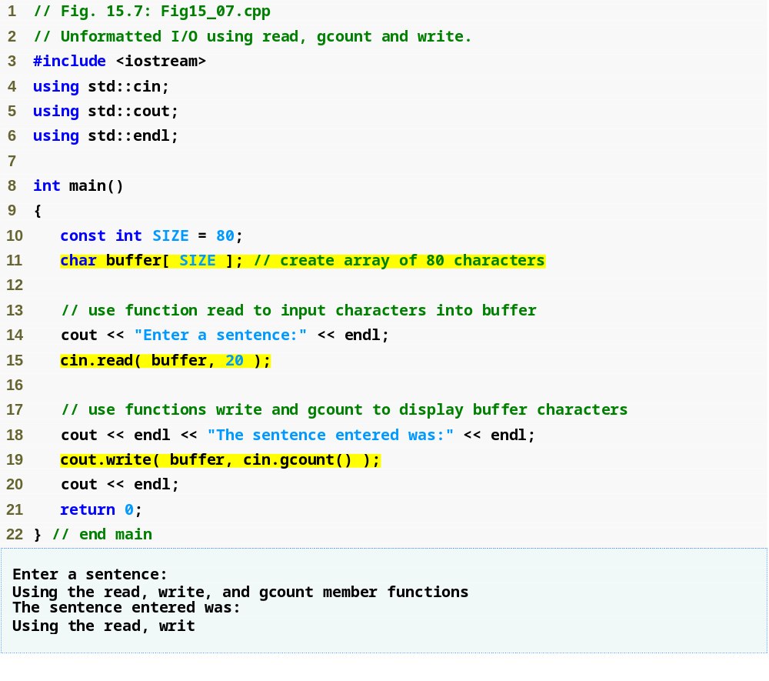
Outline
Fig15_07.cpp
(1 of 1)
read 20 bytes from the input stream to buffer
write out as many characters as were read by the last input operation from buffer to the output stream

Slide 44
15.6 Introduction to Stream Manipulators
Stream manipulators perform formatting tasks
  Setting field widths
  Setting precision
  Setting and unsetting format state
  Setting fill characters in fields
  Flushing streams
  Inserting a newline and flushing the output stream
  Inserting a null character and skipping white space in the input stream

Slide 45
15.6.1 Integral Stream Base: dec, oct, hex and setbase
Change a stream’s integer base by inserting manipulators
  hex manipulator
    Sets the base to hexadecimal (base 16)
  oct manipulator
    Sets the base to octal (base 8)
  dec manipulator
    Resets the base to decimal
  setbase parameterized stream manipulator
    Takes one integer argument: 10, 8 or 16
    Sets the base to decimal, octal or hexadecimal
    Requires the inclusion of the <iomanip> header file
  Stream base values are sticky
    Remain until explicitly changed to another base value

Slide 46
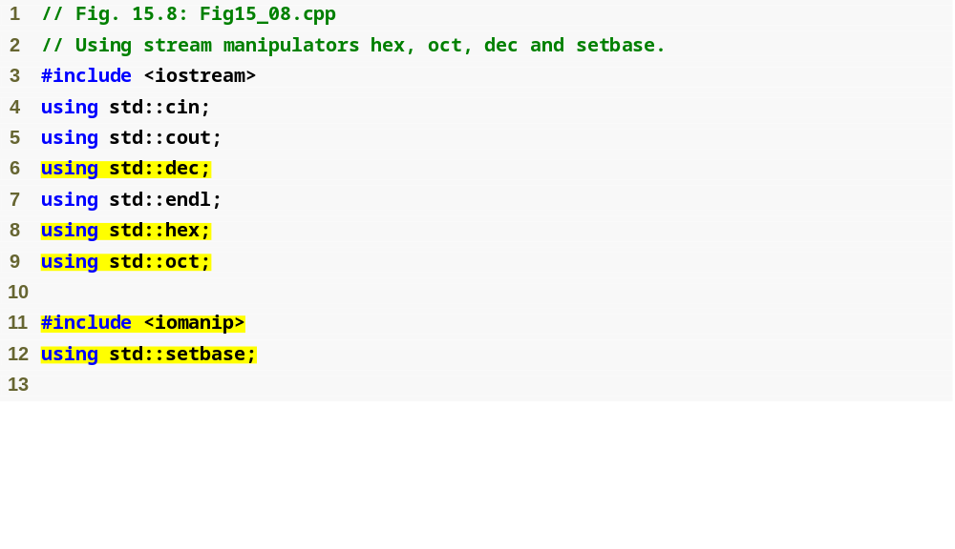
Outline
Fig15_08.cpp
(1 of 2)
Parameterized stream manipulator setbase is in header file <iomanip>

Slide 47
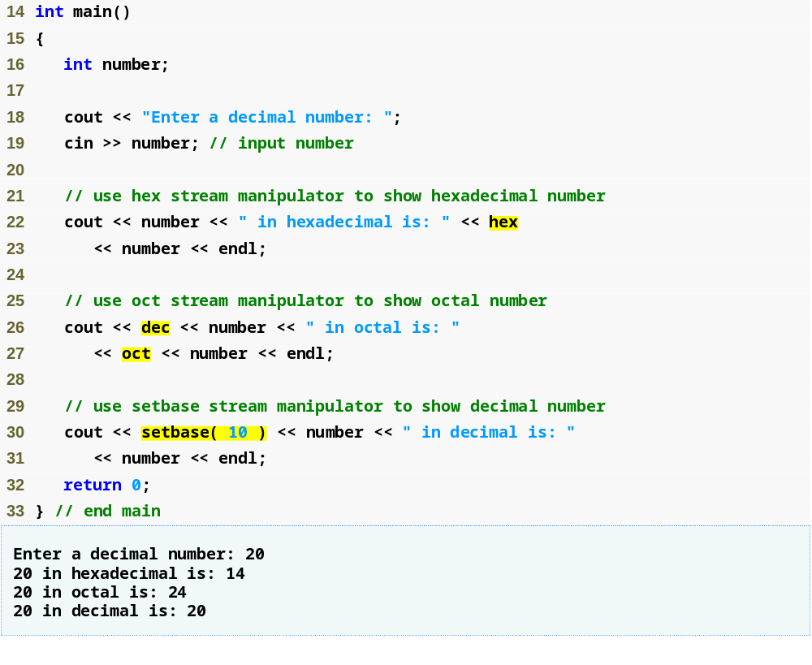
Outline
Fig15_08.cpp
(2 of 2)
Set base to hexadecimal
Set base to octal
Reset base to decimal

Slide 48
15.6.2 Floating-Point Precision (precision, setprecision)
Precision of floating-point numbers
  Number of digits displayed to the right of the decimal point
  setprecision parameterized stream manipulator
  precision member function
    When called with no arguments, returns the current precision setting
  Precision settings are sticky

Slide 49
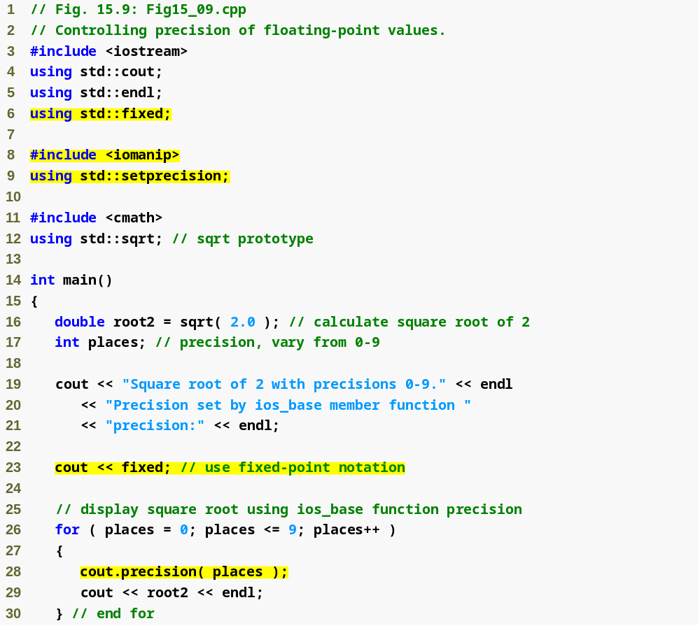
Outline
Fig15_09.cpp
(1 of 2)
Use member function precision to set cout to display places digits to the right of the decimal point

Slide 50
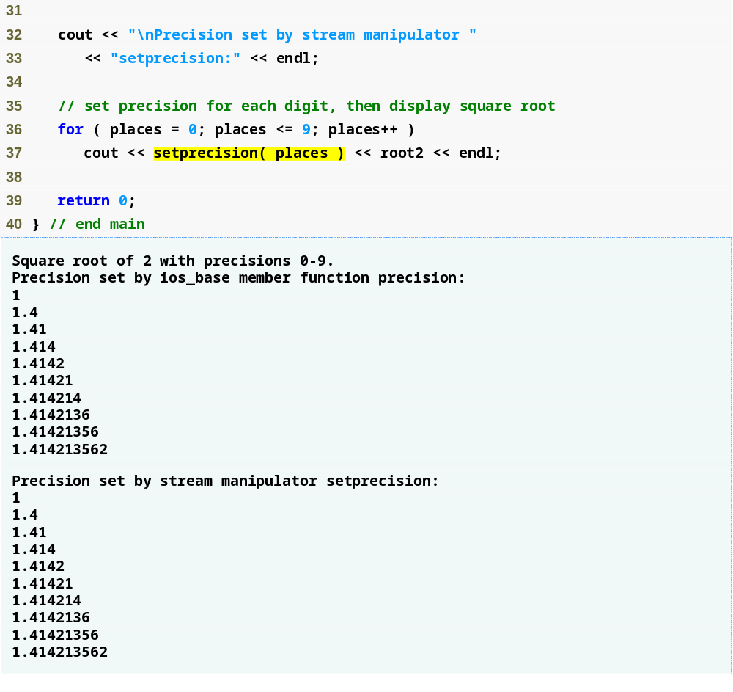
Outline
Fig15_09.cpp
(2 of 2)
Use parameterized stream manipulator setprecision to set cout to display places digits to the right of the decimal point

Slide 51
15.6.3 Field Width (width, setw)
Field width
  (for ostream) Number of character positions in which value is outputted
    Fill characters are inserted as padding
    Values wider than the field are not truncated
  (for istream) Maximum number of characters inputted
    For char array, maximum of one fewer characters than the width will be read (to accommodate null character)

Slide 52
15.6.3 Field Width (width, setw) (Cont.)
Field width (Cont.)
  Member function width of base class ios_base
    Sets the field width
    Returns the previous width
      width function call with no arguments just returns the current setting
  Parameterized stream manipulator setw
    Sets the field width
  Field width settings are not sticky

Slide 53
Common Programming Error 15.1
The width setting applies only for the next insertion or extraction (i.e., the width setting is not “sticky”); afterward, the width is set implicitly to 0 (i.e., input and output will be performed with default settings). Assuming that the width setting applies to all subsequent outputs is a logic error.

Slide 54
Common Programming Error 15.2
When a field is not sufficiently wide to handle outputs, the outputs print as wide as necessary, which can yield confusing outputs.

Slide 55
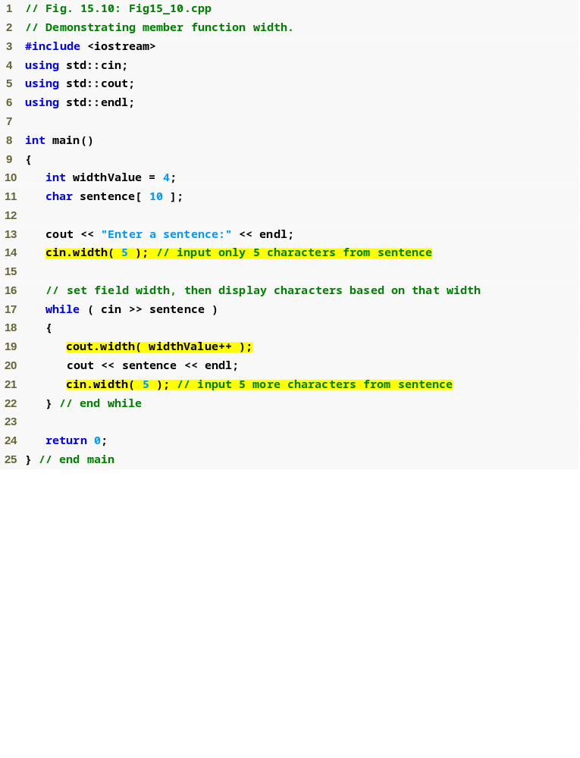
Outline
Fig15_10.cpp
(1 of 2)

Slide 56
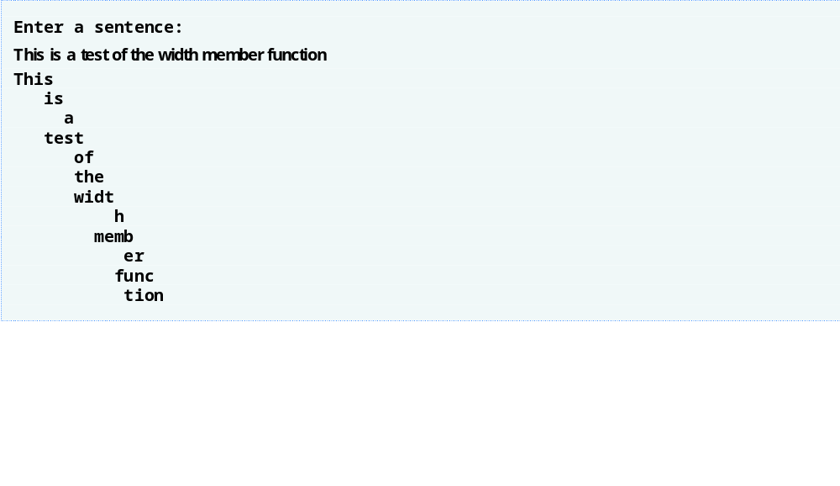
Outline
Fig15_10.cpp
(2 of 2)

Slide 57
15.6.4 Use-Defined Output Stream Manipulators
Programmers can create their own stream manipulators
  Output stream manipulators
    Must have return type and parameter type ostream &

Slide 58
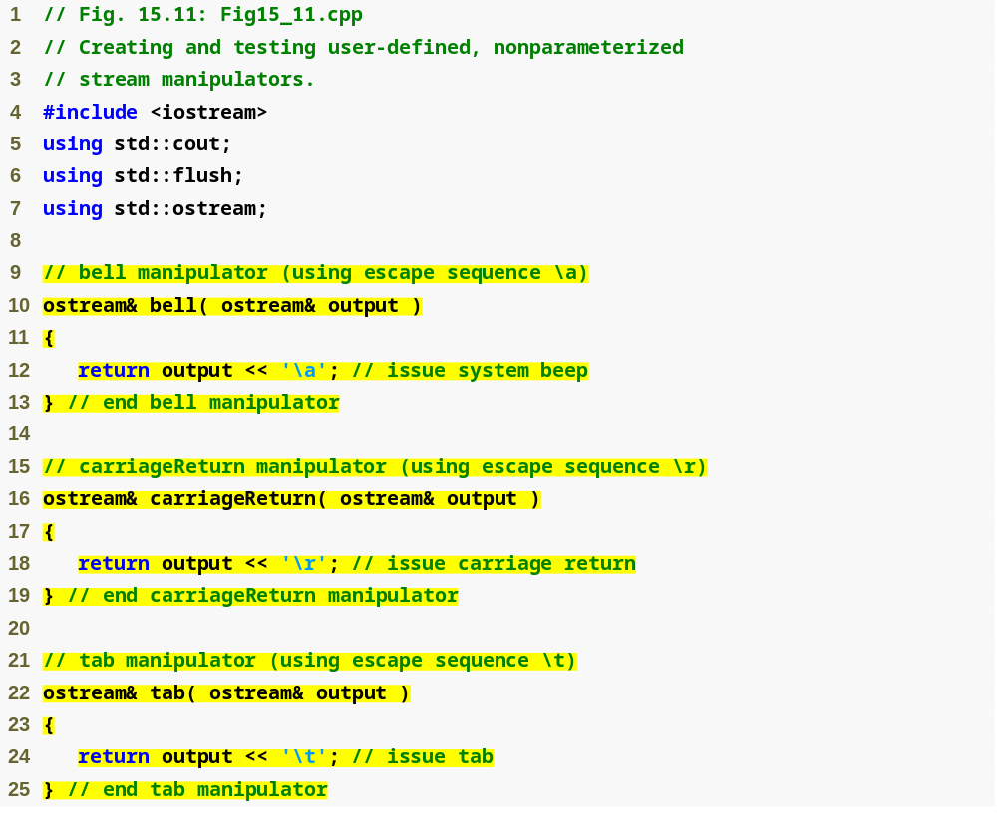
Outline
Fig15_11.cpp
(1 of 2)

Slide 59
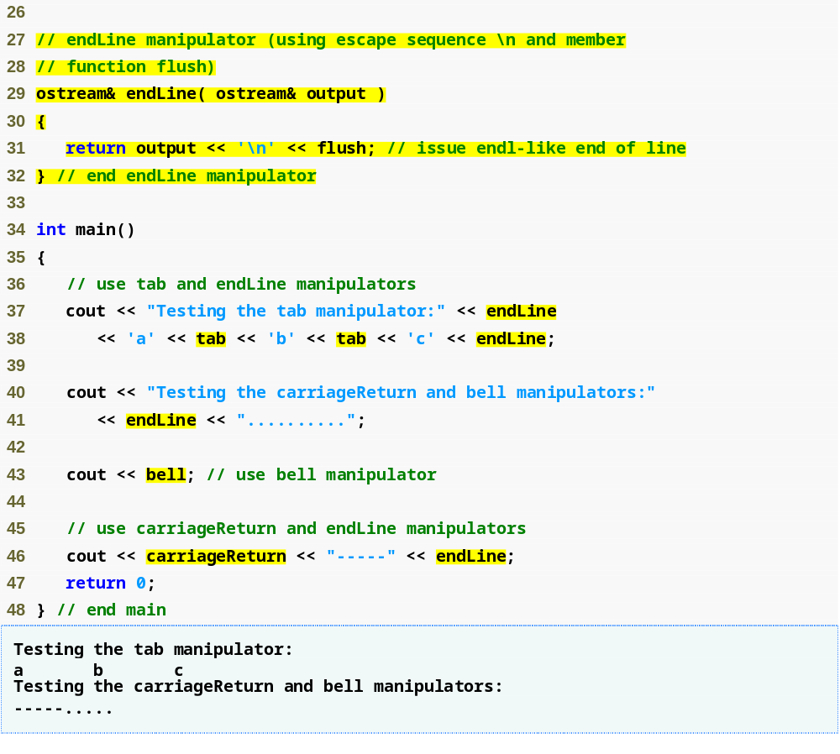
Outline
Fig15_11.cpp
(2 of 2)

Slide 60
15.7 Stream Format States and Stream Manipulators
Stream manipulators specify stream-I/O formatting
  All these manipulators belong to class ios_base

Slide 61
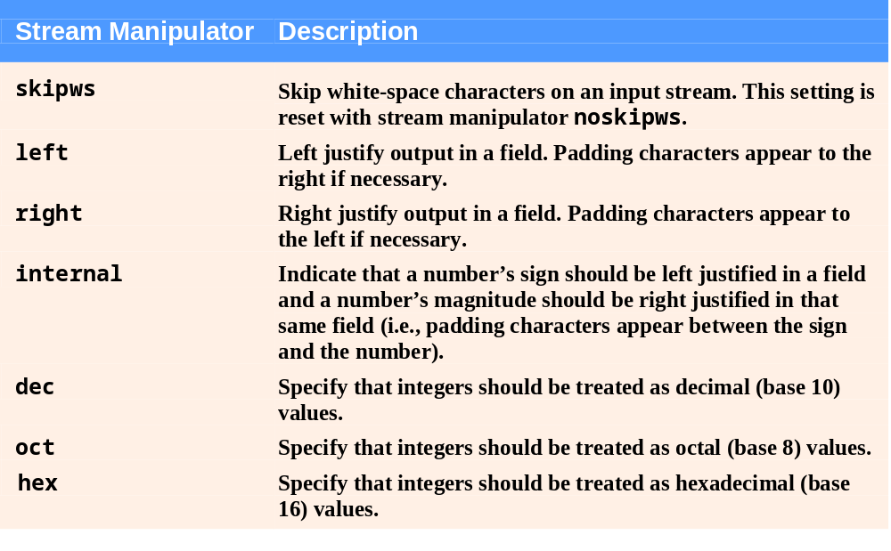
Fig. 15.12 | Format state stream manipulators from <iostream>. (Part 1 of 2)

Slide 62
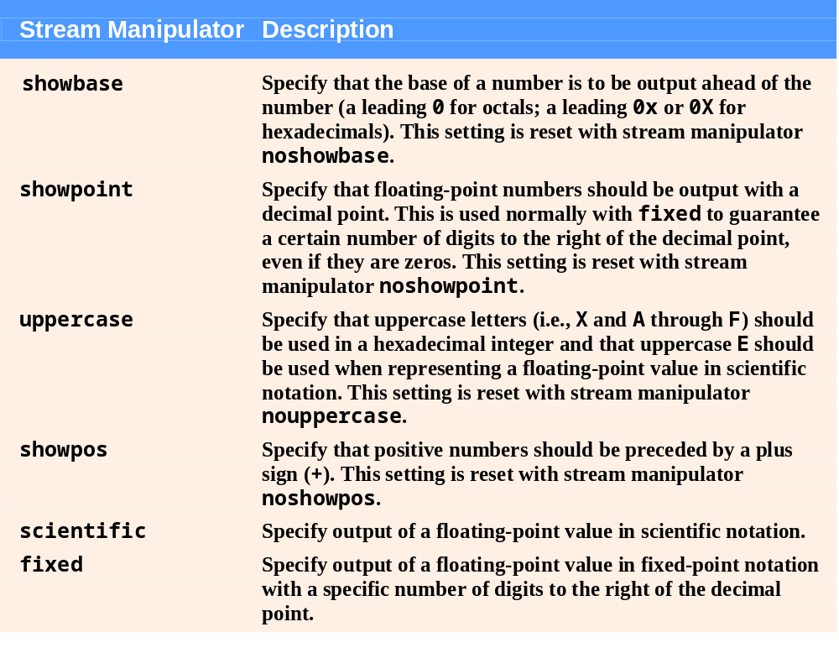
Fig. 15.12 | Format state stream manipulators from <iostream>. (Part 2 of 2)

Slide 63
15.7.1 Trailing Zeros and Decimal Points (showpoint)
Stream manipulator showpoint
  Floating-point numbers are output with decimal point and trailing zeros
    Example
      79.0 prints as 79.0000 instead of 79
  Reset showpoint setting with noshowpoint

Slide 64
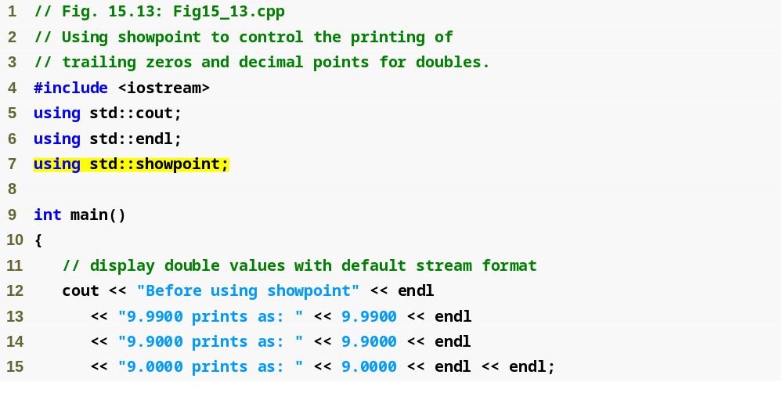
Outline
Fig15_13.cpp
(1 of 2)

Slide 65
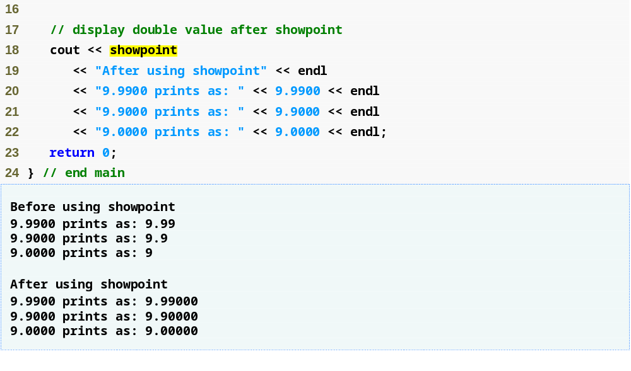
Outline
Fig15_13.cpp
(2 of 2)

Slide 66
15.7.2 Justification (left, right and internal)
Justification in a field
  Manipulator left
    fields are left-justified
    padding characters to the right
  Manipulator right
    fields are right-justified
    padding characters to the left
  Manipulator internal
    signs or bases on the left
      showpos forces the plus sign to print
    magnitudes on the right
    padding characters in the middle

Slide 67
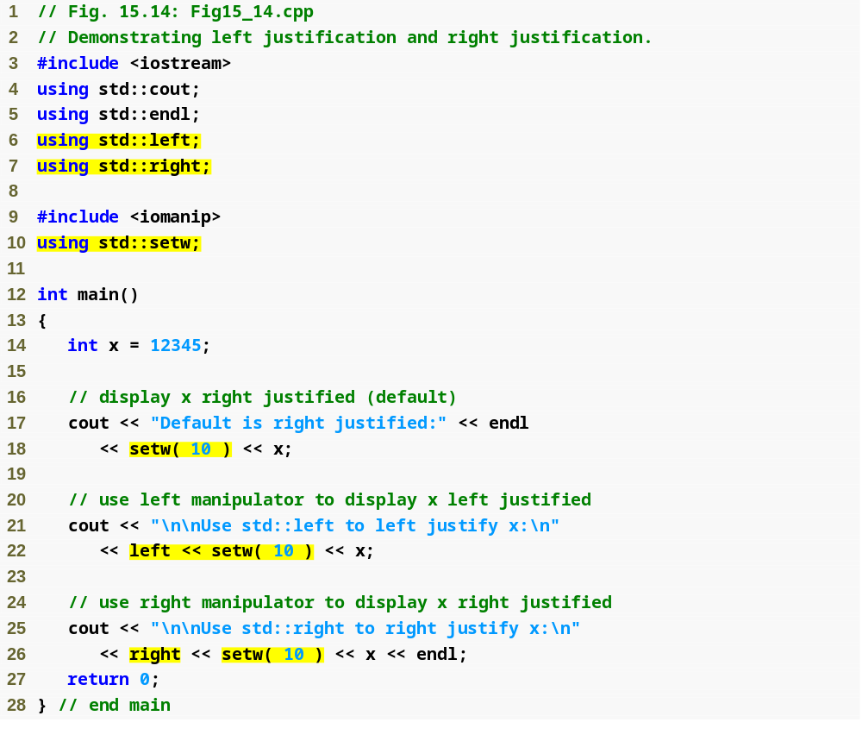
Outline
Fig15_14.cpp
(1 of 2)

Slide 68
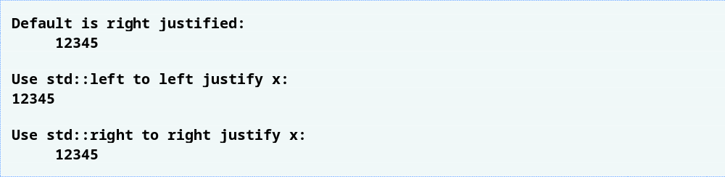
Outline
Fig15_14.cpp
(2 of 2)

Slide 69
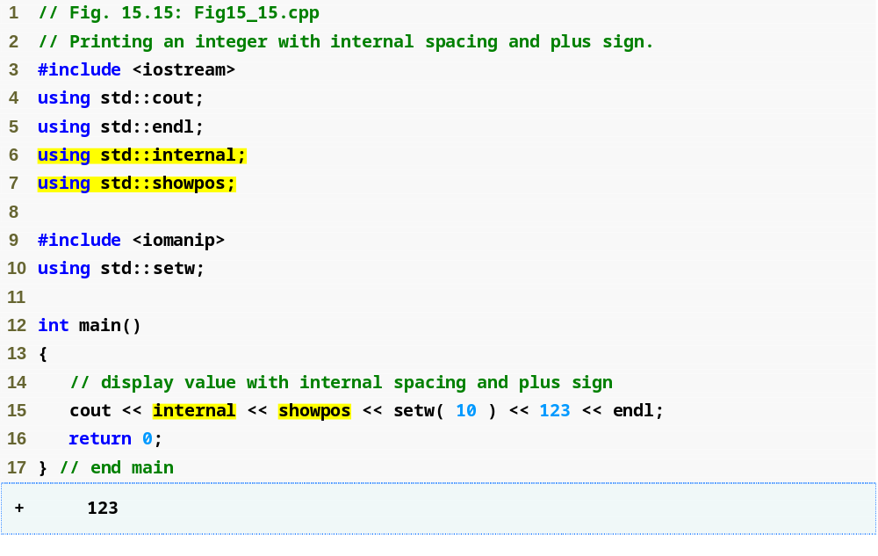
Outline
Fig15_15.cpp
(1 of 1)

Slide 70
15.7.3 Padding (fill, setfill)
Padding in a field
  Fill characters are used to pad a field
    Member function fill
      Specifies the fill character
        Spaces are used if no value is specified
      Returns the prior fill character
    Stream manipulator setfill
      Specifies the fill character

Slide 71
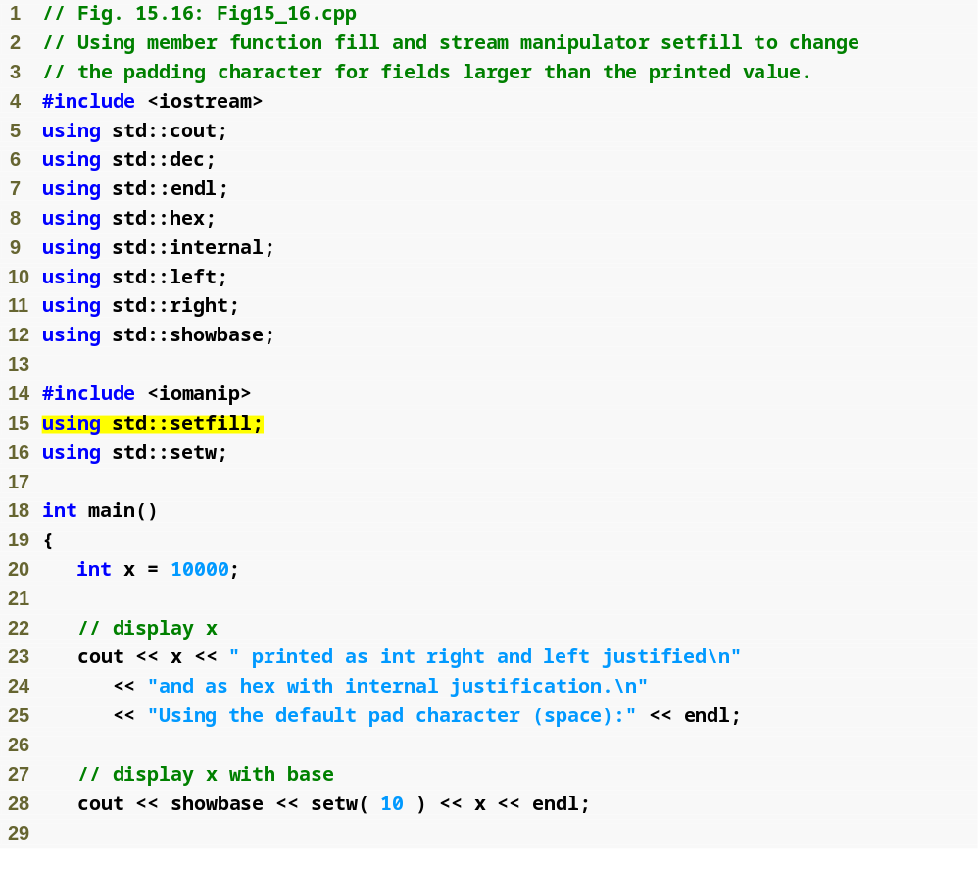
Outline
Fig15_16.cpp
(1 of 2)

Slide 72
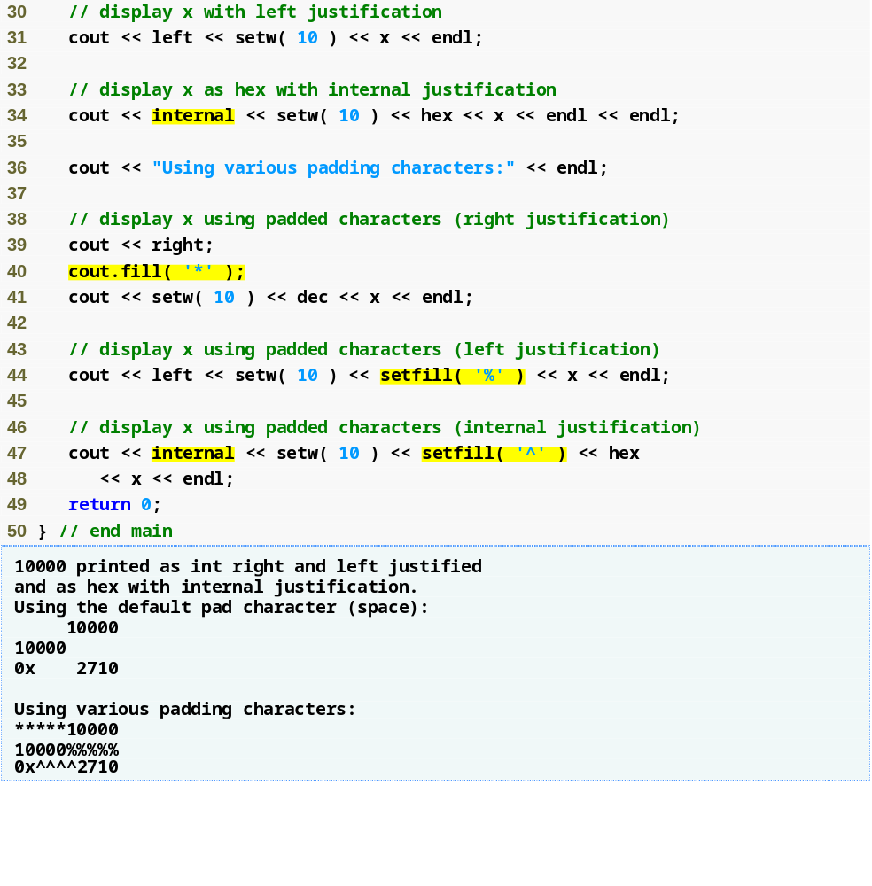
Outline
Fig15_16.cpp
(2 of 2)

Slide 73
15.7.4 Integral Stream Base (dec, oct, hex, showbase)
Integral base with stream insertion
  Manipulators dec, hex and oct
Integral base with stream extraction
  Integers prefixed with 0 (zero)
    Treated as octal values
  Integers prefixed with 0x or 0X
    Treated as hexadecimal values
  All other integers
    Treated as decimal values

Slide 74
15.7.4 Integral Stream Base (dec, oct, hex, showbase) (Cont.)
Stream manipulator showbase
  Forces integral values to be outputted with their bases
    Decimal numbers are output by default
    Leading 0 for octal numbers
    Leading 0x or 0X for hexadecimal numbers
  Reset the showbase setting with noshowbase

Slide 75
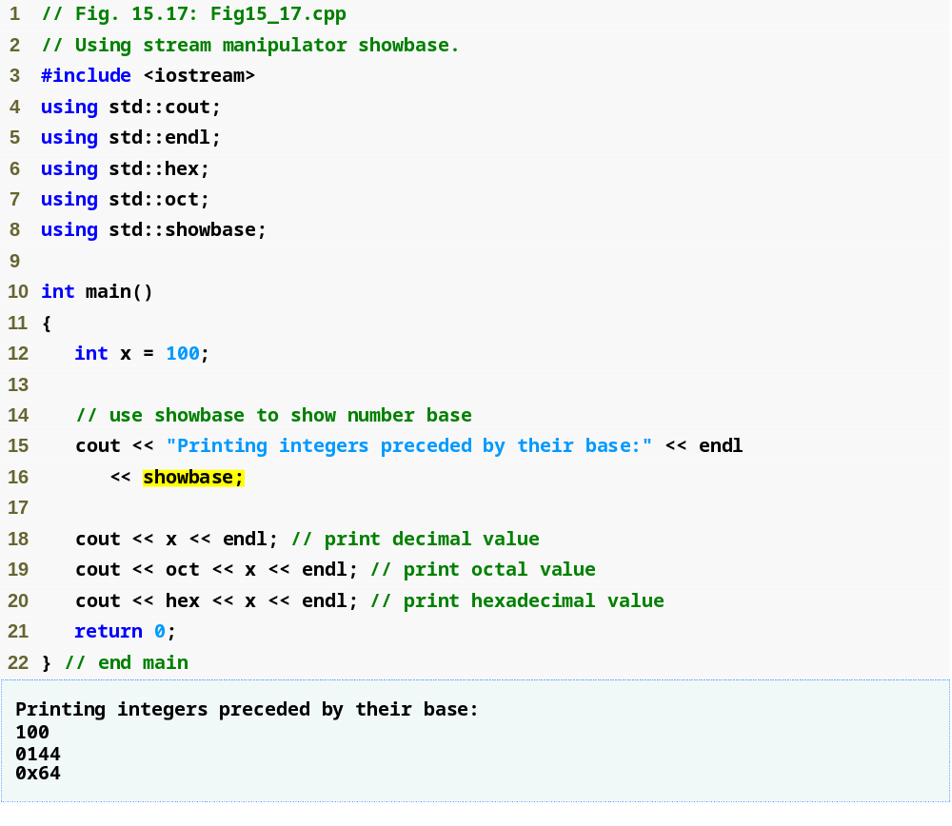
Outline
Fig15_17.cpp
(1 of 1)

Slide 76
15.7.5 Floating-Point Numbers; Scientific and Fixed Notation (scientific, fixed)
Stream manipulator scientific
  Makes floating-point numbers display in scientific format
Stream manipulator fixed
  Makes floating-point numbers display with a specific number of digits
    Specified by precision or setprecision
Without either scientific or fixed
  Floating-point number’s value determines the output format

Slide 77
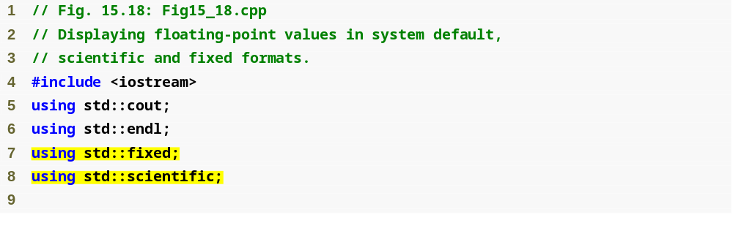
Outline
Fig15_18.cpp
(1 of 2)

Slide 78
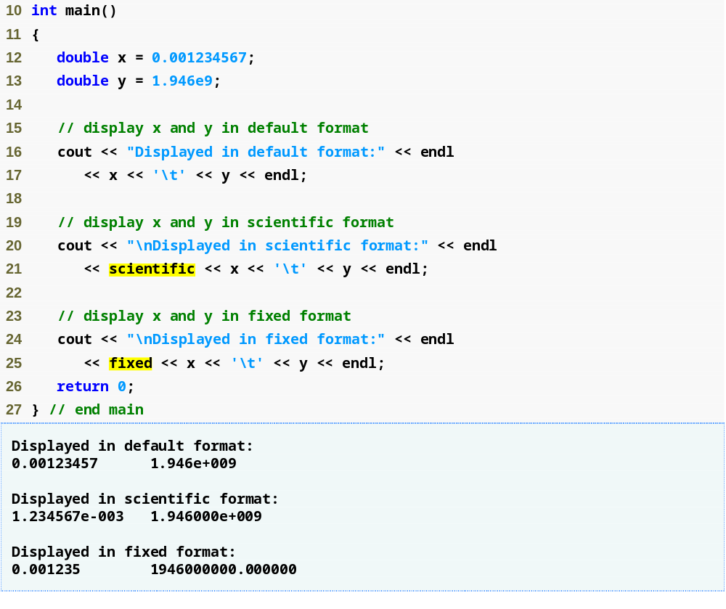
Outline
Fig15_18.cpp
(2 of 2)

Slide 79
15.7.6 Uppercase/Lowercase Control (uppercase)
Stream manipulator uppercase
  Causes hexadecimal-integer values to be output with uppercase X and A-F
  Causes scientific-notation floating-point values to be output with uppercase E
  These letters output as lowercase by default
  Reset uppercase setting with nouppercase

Slide 80
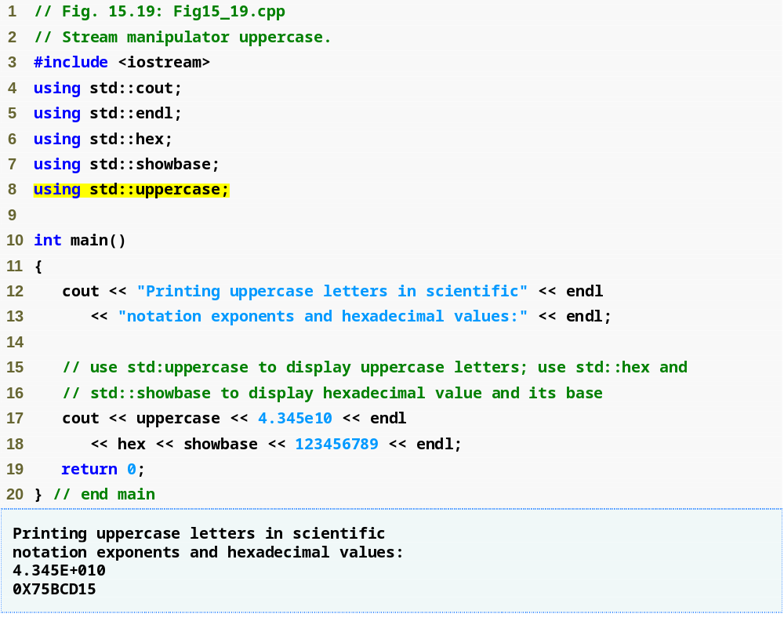
Outline
Fig15_19.cpp
(1 of 1)

Slide 81
15.7.7 Specifying Boolean Format (boolalpha)
Stream manipulator boolalpha
  Causes bool variables to output as "true" or "false"
    By default, bool variables output as 0 or 1
  noboolalpha sets bools back to displaying as 0 or 1
  bool output formats are sticky settings

Slide 82
Good Programming Practice 15.1
Displaying bool values as true or false, rather than nonzero or 0, respectively, makes program outputs clearer.

Slide 83
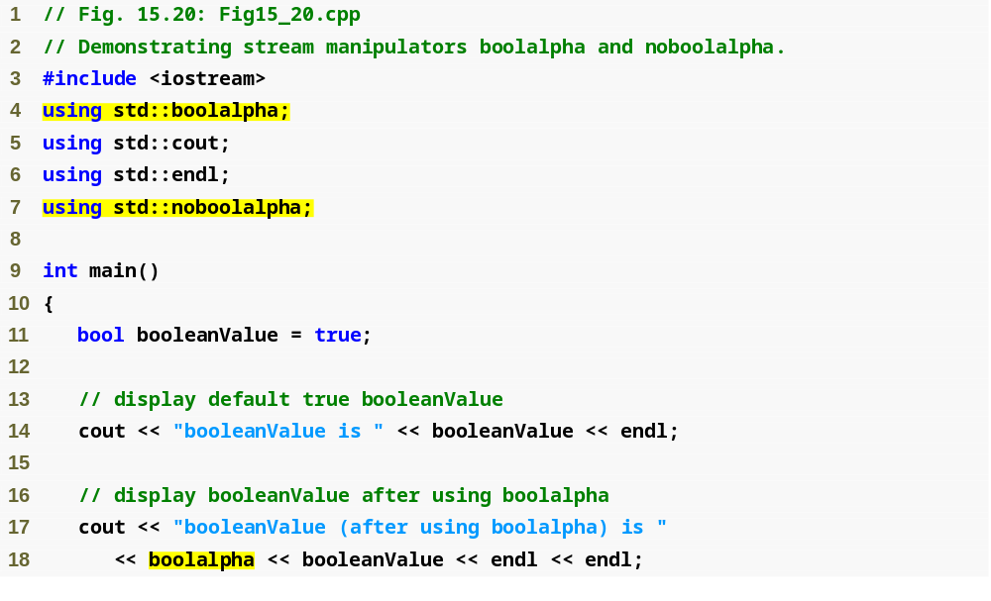
Outline
Fig15_20.cpp
(1 of 2)

Slide 84
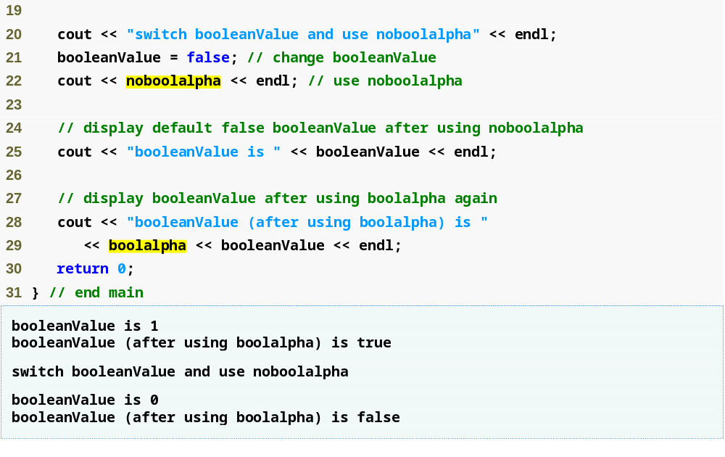
Outline
Fig15_20.cpp
(2 of 2)

Slide 85
15.7.8 Setting and Resetting the Format State via Member Function flags
Member function flags
  With no argument
    Returns a value of type fmtflags
      Represents the current format settings
  With a fmtflags as an argument
    Sets the format settings as specified
    Returns the prior state settings as a fmtflags
  Initial return value may differ across platforms
  Type fmtflags is of class ios_base

Slide 86
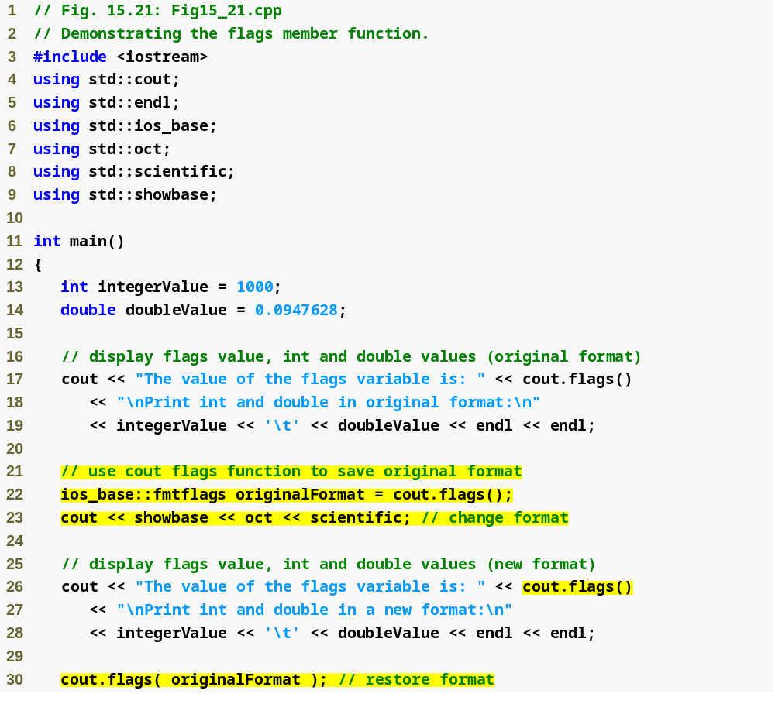
Outline
Fig15_21.cpp
(1 of 2)
Save the stream’s original format state
Restore the original format settings

Slide 87
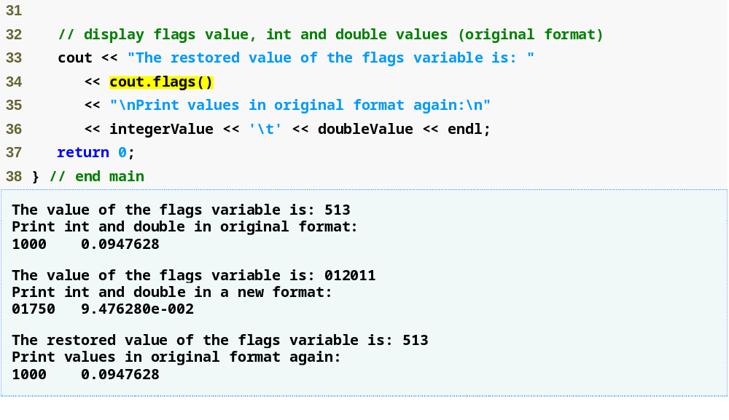
Outline
Fig15_21.cpp
(2 of 2)

Slide 88
15.8 Stream Error States
eofbit
  Set after end-of-file is encountered
  Use member function eof to check
    Returns true if end-of-file has been encountered
    Returns false otherwise
failbit
  Set when a format error occurs
    Such as a nondigit character while inputting integers
    The characters are still left in the stream
  Use member function fail to check
  Usually possible to recover from such an error

Slide 89
15.8 Stream Error States (Cont.)
badbit
  Set when an error that loses data occurs
  Use member function bad to check
  Such a serious failure is generally nonrecoverable
goodbit
  Set when none of eofbit, failbit or badbit is set
  Use member function good to check
Member function rdstate
  Returns the error state of the stream
    Incorporates eofbit, badbit, failbit and goodbit
  Using the individual member functions is preferred

Slide 90
15.8 Stream Error States (Cont.)
Member function clear
  Sets the specified bit for the stream
  Default argument is goodbit
  Examples
    cin.clear();
      Clears cin and sets goodbit
    cin.clear( ios::failbit );
      Sets failbit

Slide 91
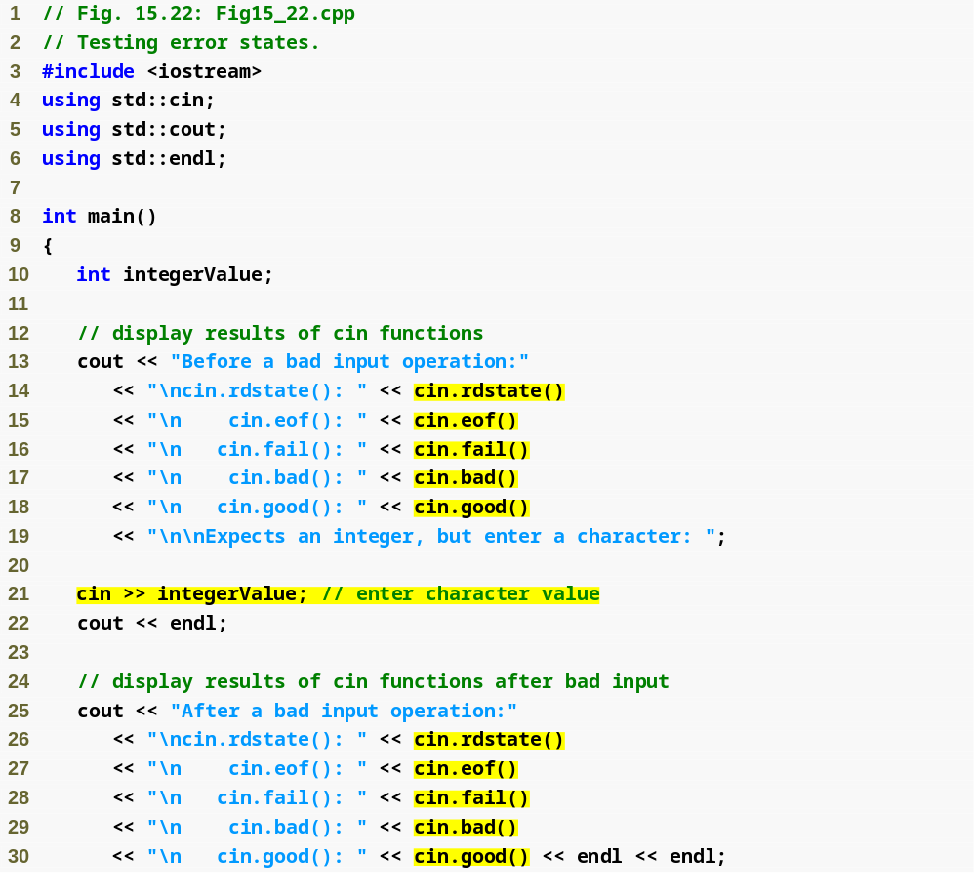
Outline
Fig15_22.cpp
(1 of 2)

Slide 92
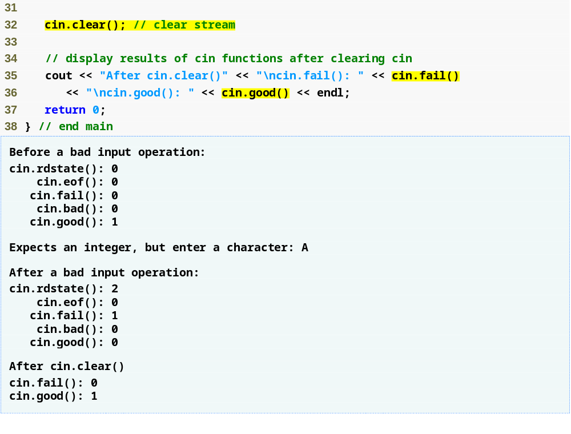
Outline
Fig15_22.cpp
(2 of 2)

Slide 93
15.8 Stream Error States (Cont.)
basic_ios member function operator!
  Returns true if either badbit or failbit is set
basic_ios member function void *
  Returns false if either badbit or failbit is set

Slide 94
15.9 Tying an Output Stream to an Input Stream
istream member function tie
  Synchronizes an istream and an ostream
    Ensures outputs appear before their subsequent inputs
  Examples
    cin.tie( &cout );
      Ties standard input to standard output
      C++ performs this operation automatically
    inputStream.tie( 0 );
      Unties inputStream from the ostream it is tied to

